Slide 1

Library Management System
Presented by Team 9
G.Joshitha Rani(24B11CS119)
G.Yamini(24B11CS146)
P.Likhitha(24B11CS351)
Y.Gladis Esther(24B11CS496)

Slide 2

Introduction
The objective of this project is to design and develop a console-based Library Management System using Core Java and JDBC that helps in efficient management of library book records.
The system allows the user to add, view, search, update, and delete book details such as book ID, title, author, price, and quantity, which are stored in a relational database.
This project aims to provide practical understanding of Java programming concepts, JDBC connectivity, and SQL-based CRUD operations.
It also focuses on implementing basic validation and exception handling to ensure data accuracy and reliability, without using any frontend technologies.

Slide 3
Problem Statement
Libraries require a reliable and organized way to manage book records such as book name, author, price, and quantity. As the number of books increases, maintaining and updating these details without a proper system becomes inefficient and time-consuming.
In the absence of a structured application, tasks like adding new books, updating book information, deleting outdated records, and searching for books become difficult and prone to errors. There is also no centralized way to store and retrieve book data securely and accurately.
Therefore, there is a need for a simple Java-based application that connects to a database and supports basic CRUD operations (Create, Read, Update, Delete) to manage library book records effectively. The system should ensure easy data handling, better organization, and improved accuracy without using any frontend technologies.

Slide 4
Modules
1. Book Management Module
Allows adding new book records
Allows updating book details
Allows deleting book records
2. Search Module
Search books using:
  Book ID
  Book Name
  Author Name

Slide 5
3. Database Connectivity Module
Establishes connection between Java application and database
Executes SQL queries using JDBC
4. Validation Module
Validates book price
Validates book quantity
Prevents incorrect data entry
5. Exception Handling Module
Handles invalid book ID
Handles database and input errors

Slide 6
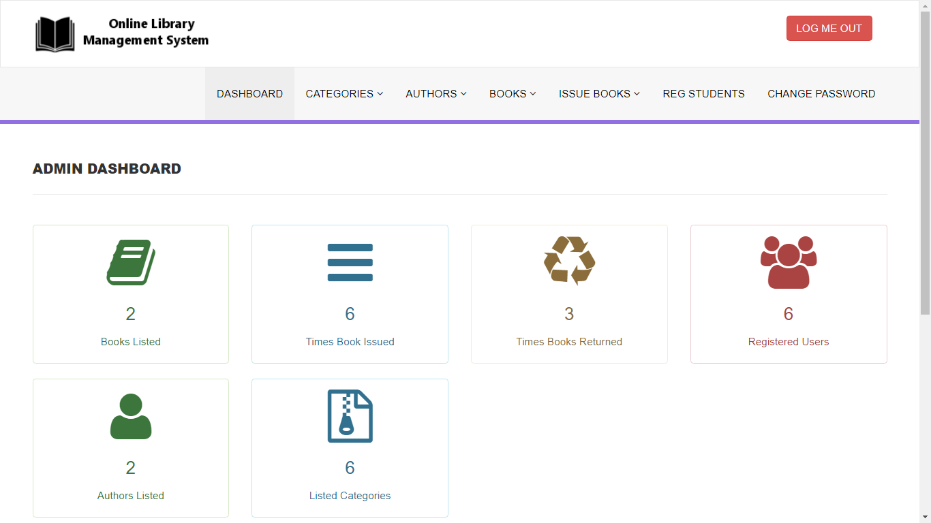

Slide 7
Role Contributions
G.Yamini -Book Management Developer
Works on adding, updating, and deleting book records
Handles book-related logic in Java
P.Likhitha- Search & Validation Developer
Implements book search by ID, name, and author
Handles price and quantity validation
G.Joshitha Rani- Database & JDBC Developer
Designs the books table
Manages JDBC connection and SQL queries
Y.Gladis Esther- Testing & Documentation Lead
Tests all CRUD operations
Prepares PPT, documentation, and review content

Slide 8
Software Requirements
Operating System: Windows / Linux
Programming Language: Java (J2SE)
JDK Version: JDK 8 or above
Database: MySQL / Oracle / SQLite
Database Connectivity: JDBC (Java Database Connectivity)
IDE: VS Code / Eclipse / IntelliJ / NetBeans

Slide 9
Conclusion
The Library Management System is designed to provide a simple and effective solution for managing library book records such as book name, author, price, and quantity. The project addresses the difficulties faced by libraries in maintaining and updating book information without a proper system.
By using Core Java and JDBC, the proposed system allows book records to be stored securely in a database and managed through basic CRUD operations. The system helps in organizing data, reducing manual effort, and minimizing errors while handling library records.
.

Slide 10
This project provides practical exposure to Core Java, JDBC connectivity, SQL operations, and exception handling.
Since the system is console-based and backend-focused, it strengthens core programming concepts and builds a strong foundation for future enhancements, such as adding a user interface or extending library functionalities.

